Slide 1
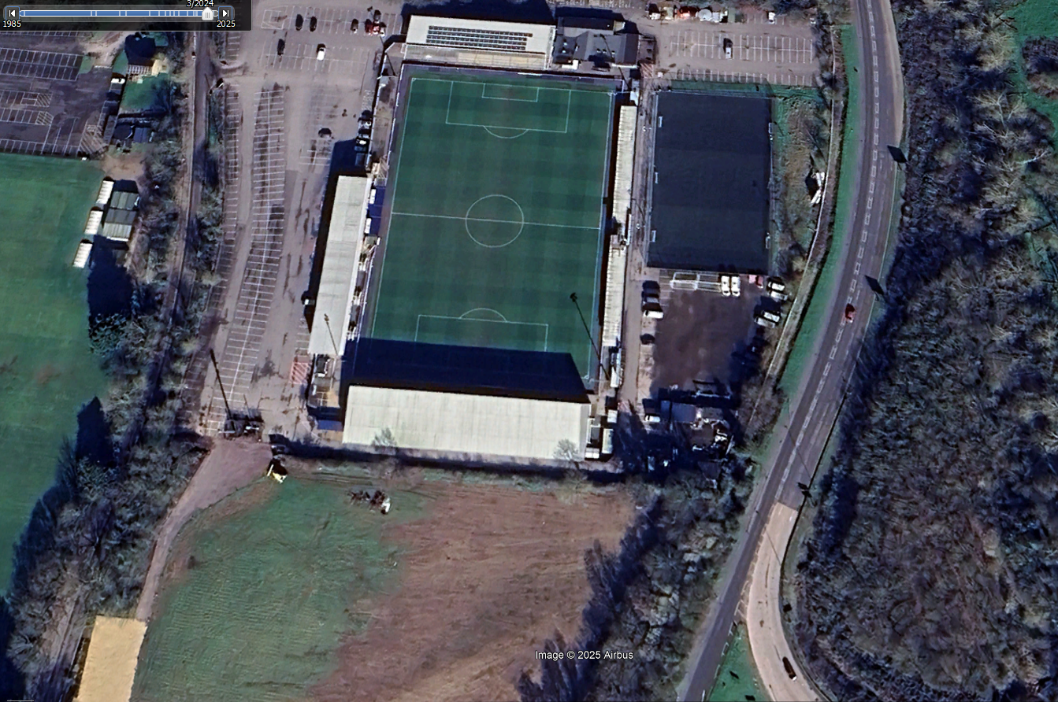
March 2024

Slide 2
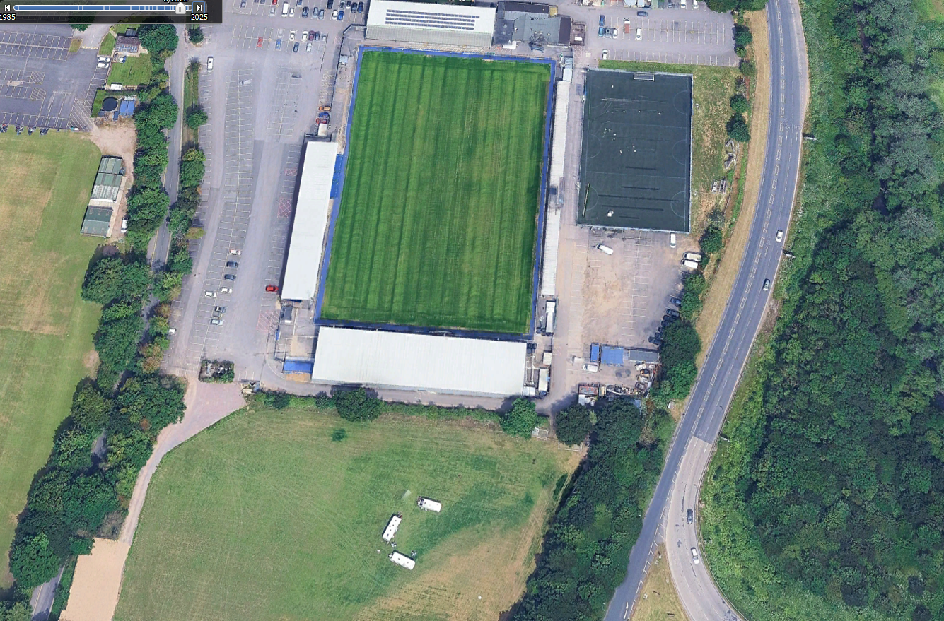
August 23
Sports fields
built on
without planning?

Slide 3
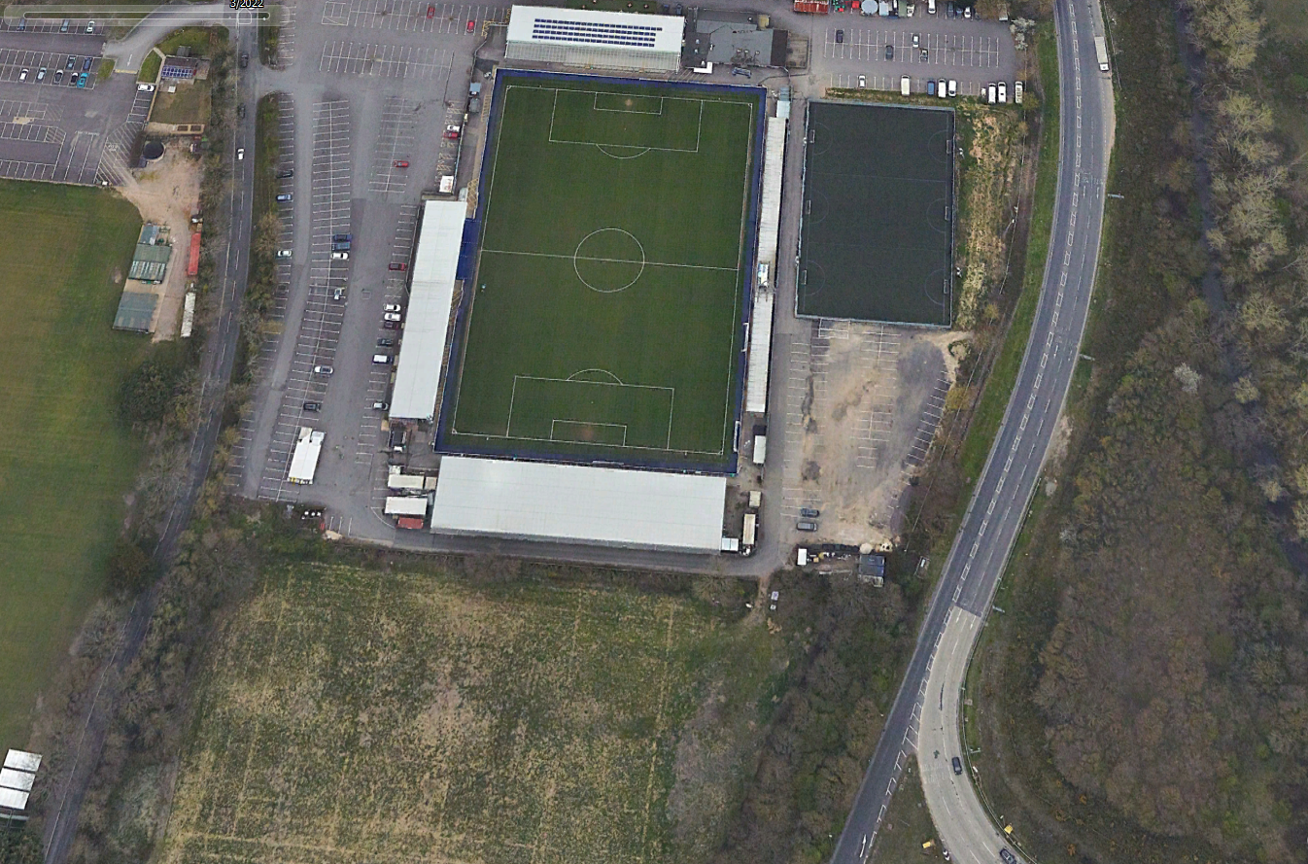
March 2022

Slide 4
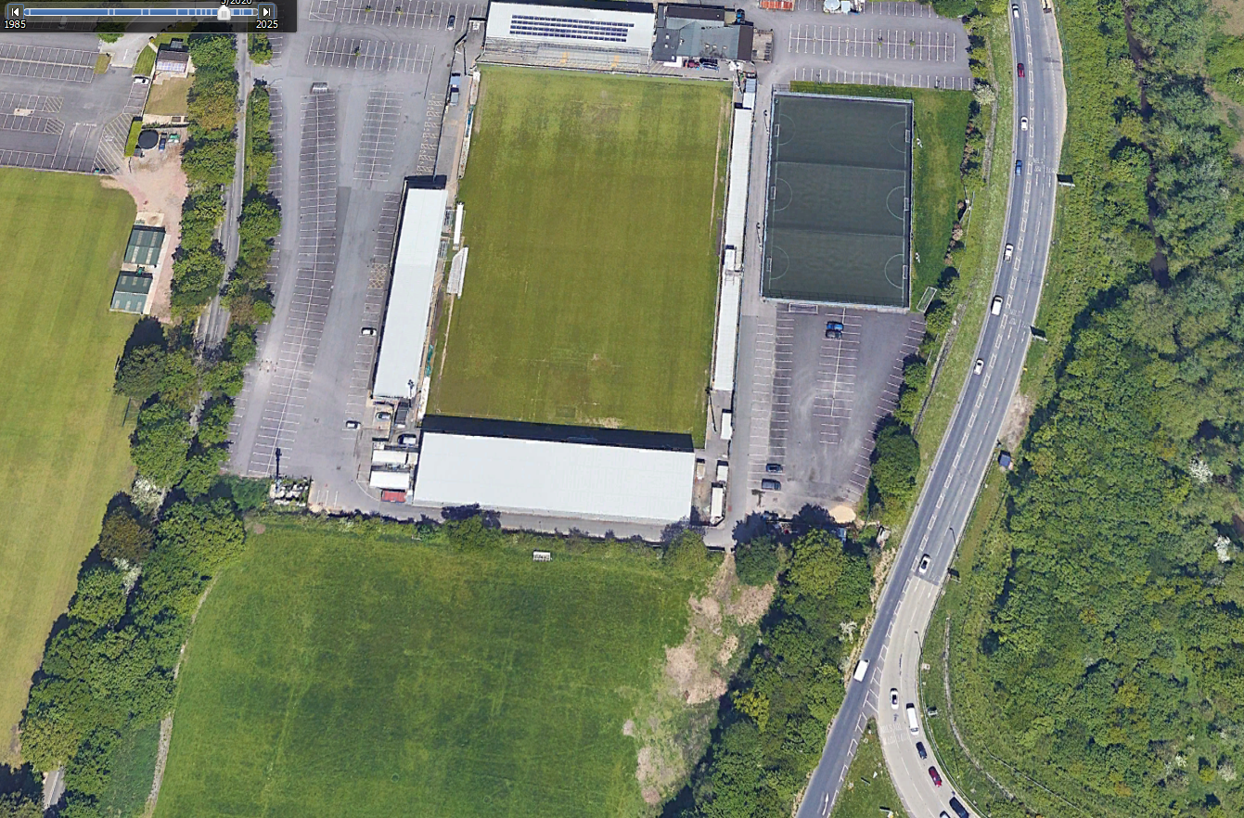
May 2020

Slide 5
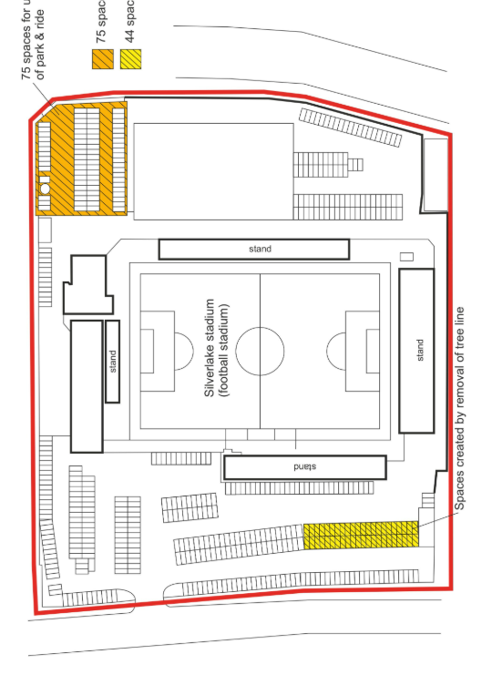
Parking spaces shown on 2020 planning application
F/19/86043

