Slide 1
Bursledon, Hamble-le-Rice and Hound Local Area Committee
18 July 2024
18:00

Slide 2
Planning Guidelines

Slide 3
How Proposals Are Determined
Proposal must be considered on planning grounds.
The Committee must determine proposals in line with Development Plan, unless material considerations indicate otherwise.
The Development Plan –adopted Eastleigh Borough Local Plan 2016-2036 and Hampshire Minerals and Waste Plan.

Slide 4
Relevant Considerations
Adopted Supplementary Planning Documents relating to matters such as Quality Places, Residential Parking Standards and Planning Obligations.
Relevant Government Policy including the National Planning Policy Framework and its presumption in favour of sustainable development.
National Planning Policy Framework (2023) is a material consideration of significant weight that takes precedence over Development Plan policies which do not accord with NPPF.

Slide 5
NPPF (Amended 2023)
NPPF Key Planning Requirements:
  Deliver sustainable development without delay;
  Meet housing needs & significantly boost delivery of housing;
  Promote growth of economy;
  Require high standard of design;
  Prevent or mitigate impacts.
Includes a “presumption in favour of sustainable development” unless adverse impacts outweigh benefits.
3 threads of sustainability – economic, social and environmental - are interdependent and need to be pursued in mutually supportive ways.

Slide 6
Other Material Considerations
Planning history / previous applications or decisions;
Appeal decisions;
Site specific policies;
Site specific matters – highway matters, residential amenity, infrastructure, biodiversity, contaminated land, noise, drainage;
Consultee and 3rd party comments;
Precedent (current case law);
5 year housing land supply.

Slide 7
Non-Planning Issues
Moral, racial or religious views;
Devalued property;
Loss of private view;
Breach of covenant;
Matters covered by other laws or legislation e.g. building regulations, alcohol licence, environmental permits, care uses etc;
Personal views about the character of applicants;
Civil matters, e.g. boundary disputes.

Slide 8
Types of Planning Applications
Full Application (all matters considered);
Listed Building (only matters considered relating to the integrity of the listed building)
Followed by Discharge of Condition applications.
LPA is required to consider whether otherwise unacceptable development could be made acceptable through the use of conditions which are then discharged and complied with.
6 tests - necessary; relevant to planning and to the development to be permitted; enforceable; precise and; reasonable in all other respects.

Slide 9
Agenda Item 9
F/24/97033
BADNAM COTTAGE, HIGH STREET, BURSLEDON, SOUTHAMPTON, SO31 8DJ
Demolition of existing dwelling and replacement with 1.no 4-bedroom dwelling.

Slide 10
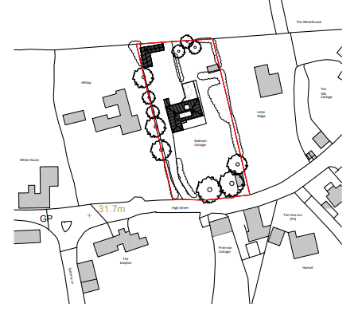
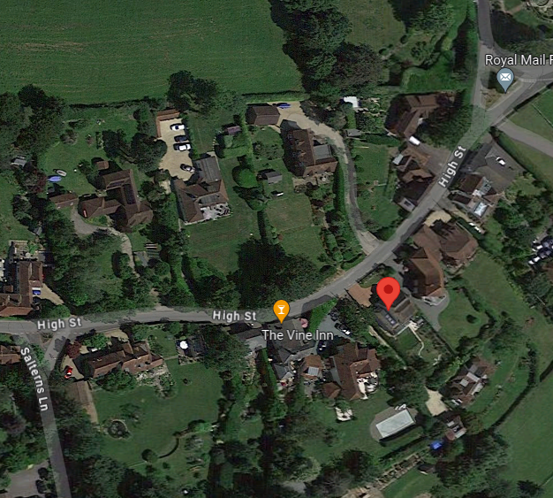
Site Location
Notes:
Detached dwelling located on the north side of High Street in Old Bursledon. Single storey with first floor in roofspace. Access via relatively steep driveway from High Street.

Slide 11
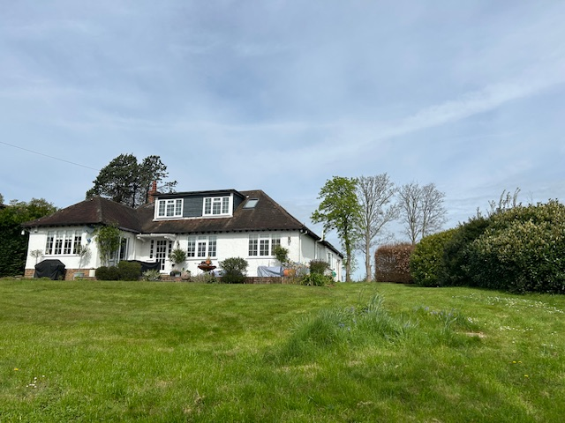
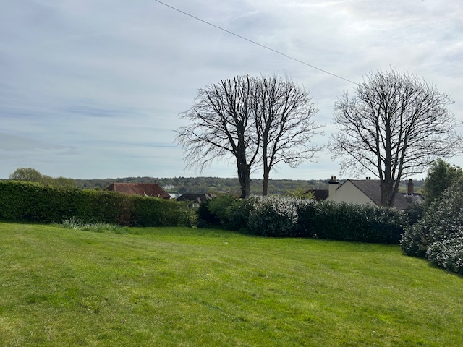
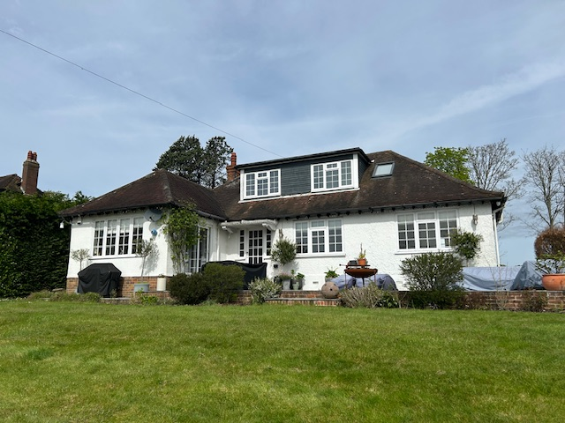
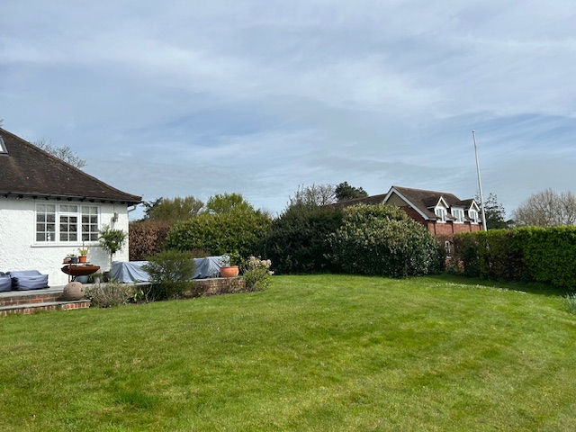
Site pictures
1.
2.
4.
3.
Notes:
South elevation (rear) with rear garden
View from rear to the River Hamble beyond
Rear elevation
Neighbour at Little Ridge (to east) demonstrates a similar architecture to the proposed

Slide 12
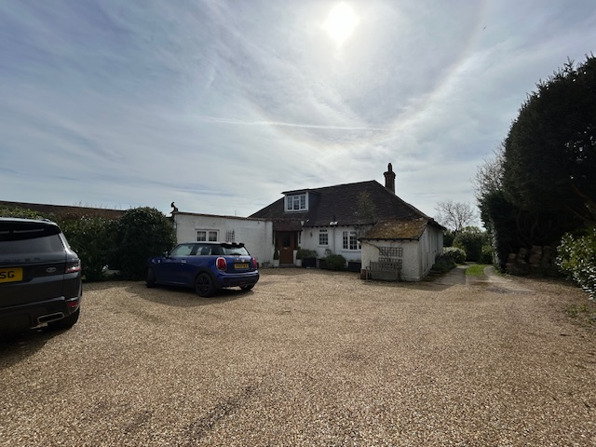
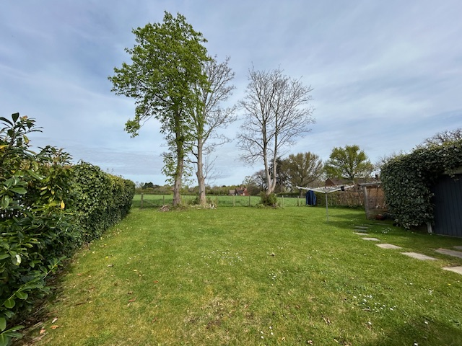
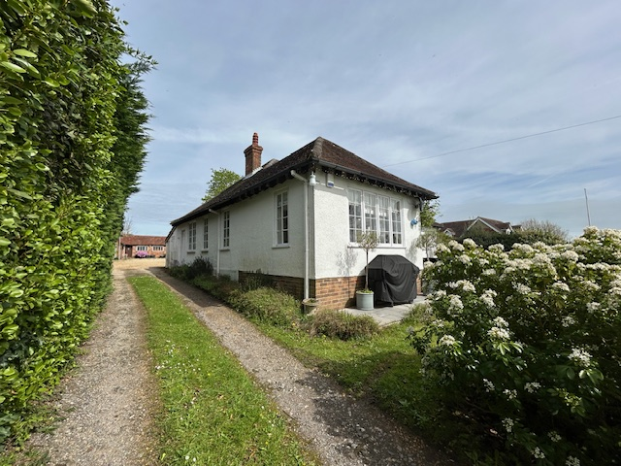
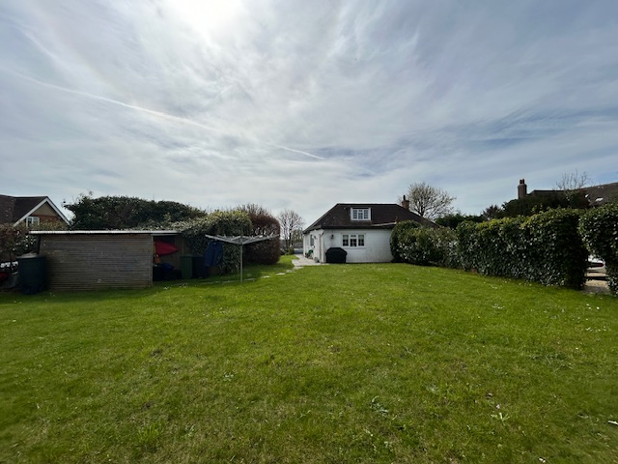
Site pictures
5.
6.
8.
7.
Notes:
5. Front (north) elevation with available parking
6. North view to a field
7. North elevation looking from northern garden – adjacent to parking
8. Dwelling as you approach up the access track from High Street

Slide 13
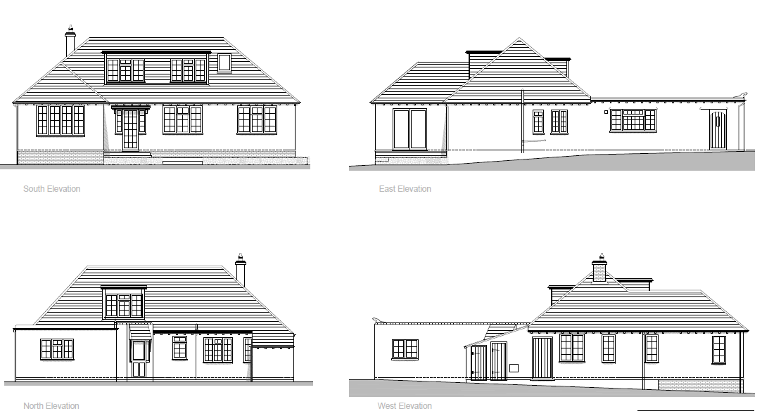
Existing Plans

Slide 14
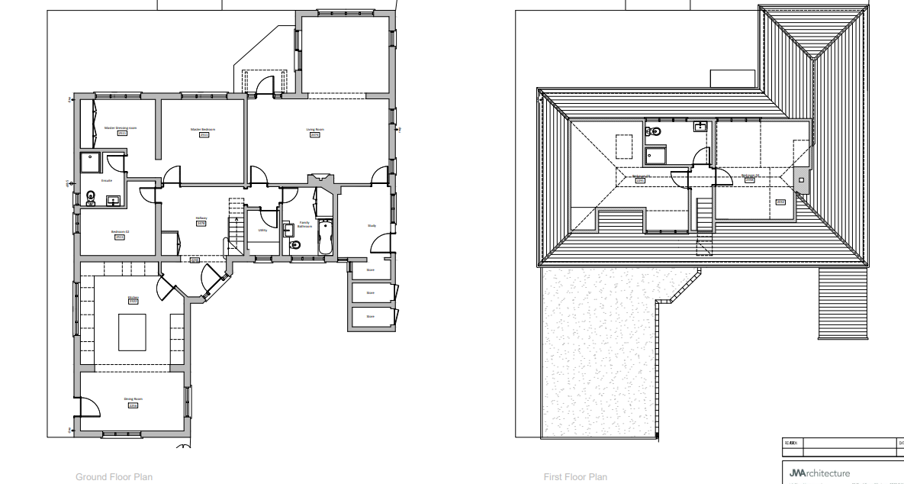
Existing floorplans

Slide 15
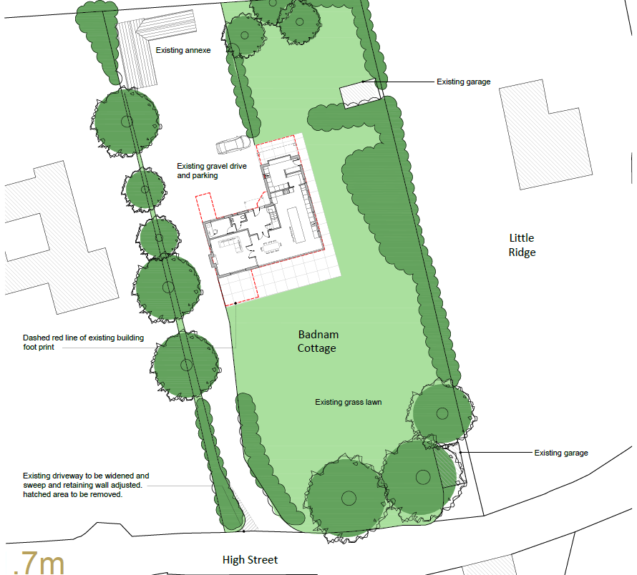
Proposed Site Plan
Notes:
Permission sought for the construction of a replacement dwelling after demolition of existing. New house constructed on a smaller footprint. Access would be widened with a larger ‘sweep’ and the retaining wall adjusted.

Slide 16
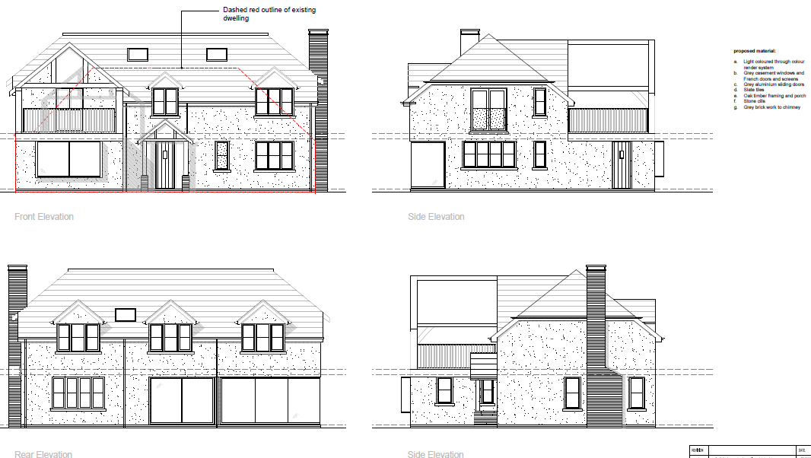
Proposed Plans
Notes:
Proposed house would be two-storey in height with the first floor partially within the roofspace served by dormer windows. Balcony to north elevation with lightweight frame.

Slide 17
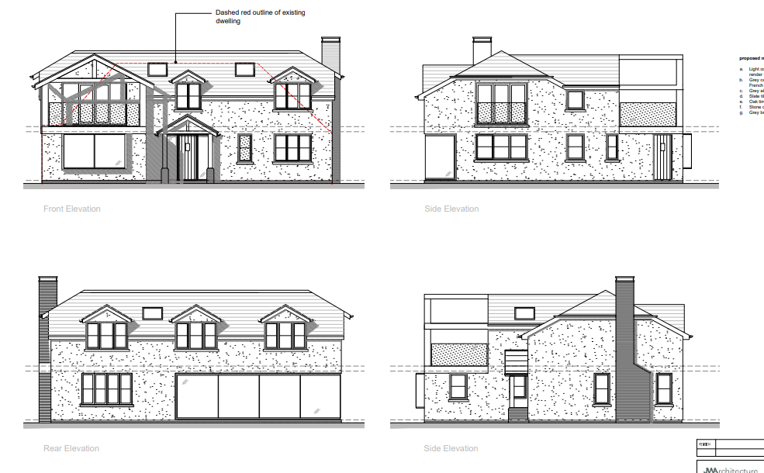
Original proposed elevations (prior to amendments)

Slide 18
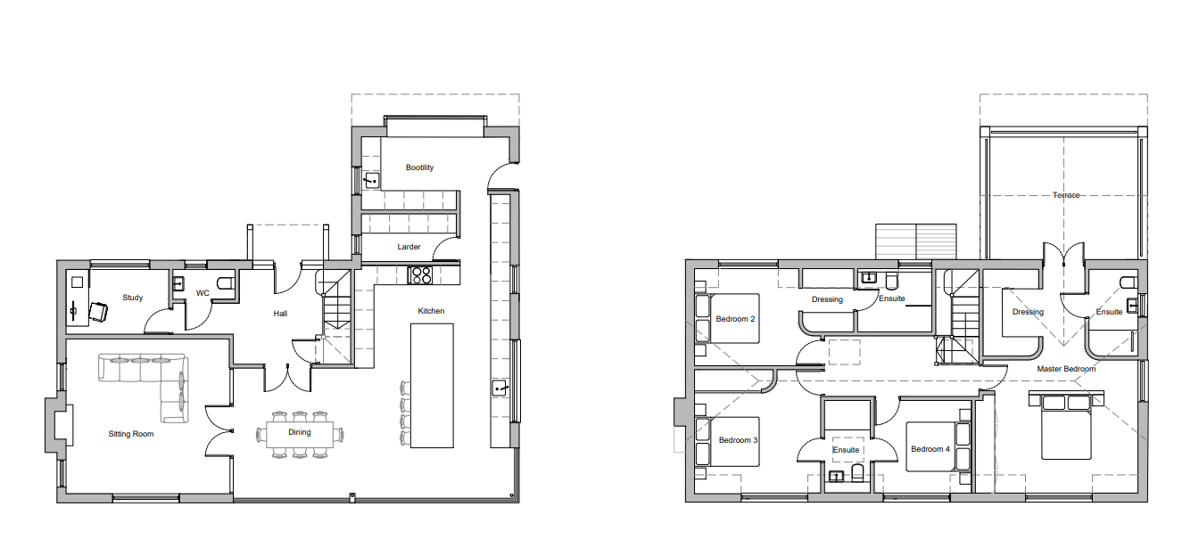
Proposed floorplans
Notes:
New dwelling would have four bedrooms on the first floor, same number as existing (although two of existing bedrooms were on the ground floor). Ground floor would have open plan living, dining space, separate sitting room, study and utility room.

Slide 19
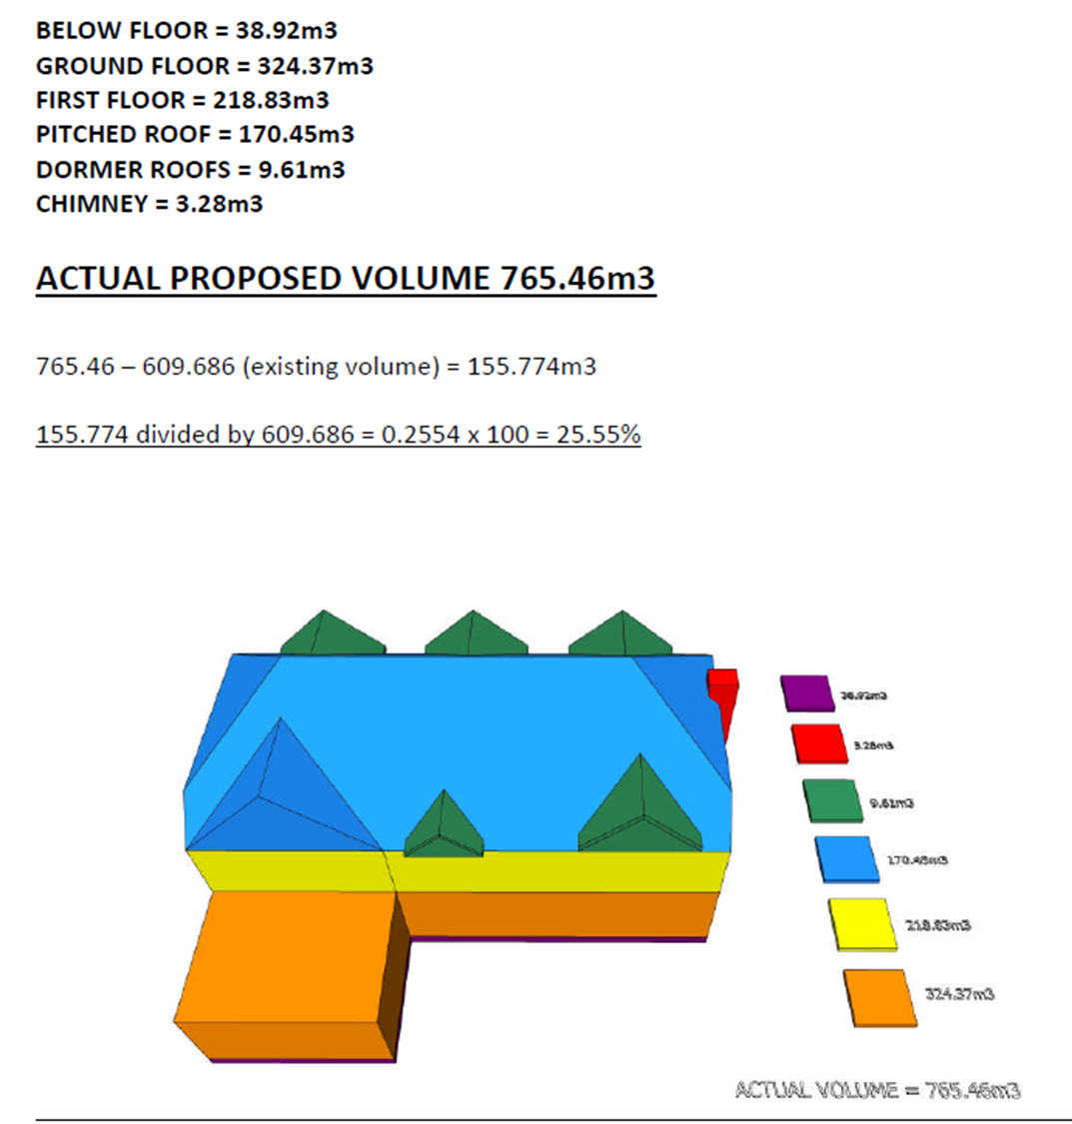
Volume calculations
Proposed 25.55% volume increase.

Slide 20
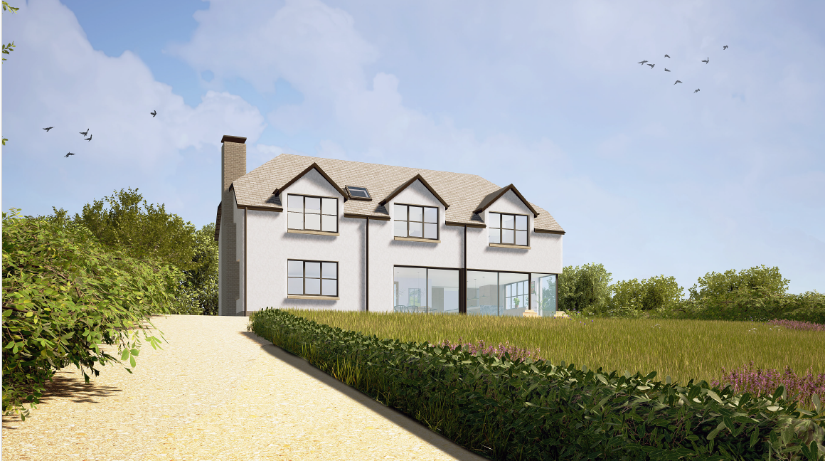
Notes:
This is the elevation facing High Street. Distance from Hamble River to south is approx. 700m.

Slide 21
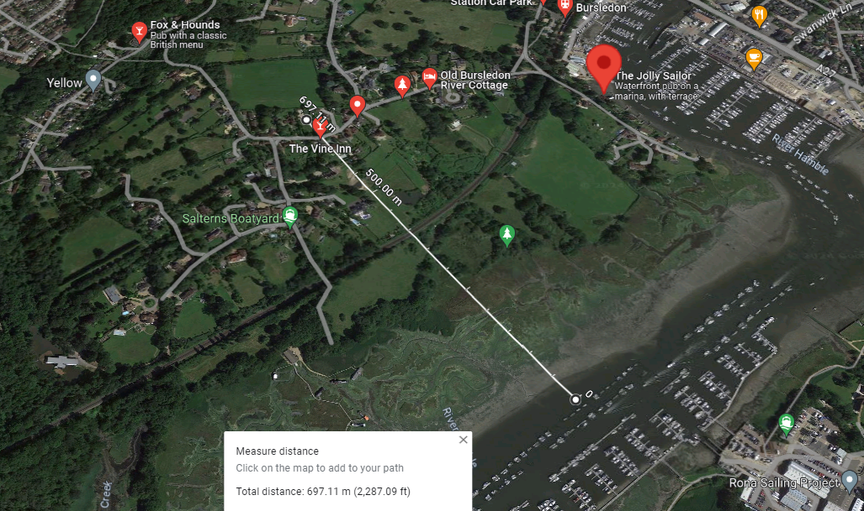
Notes:
Approx 700m from river.

Slide 22
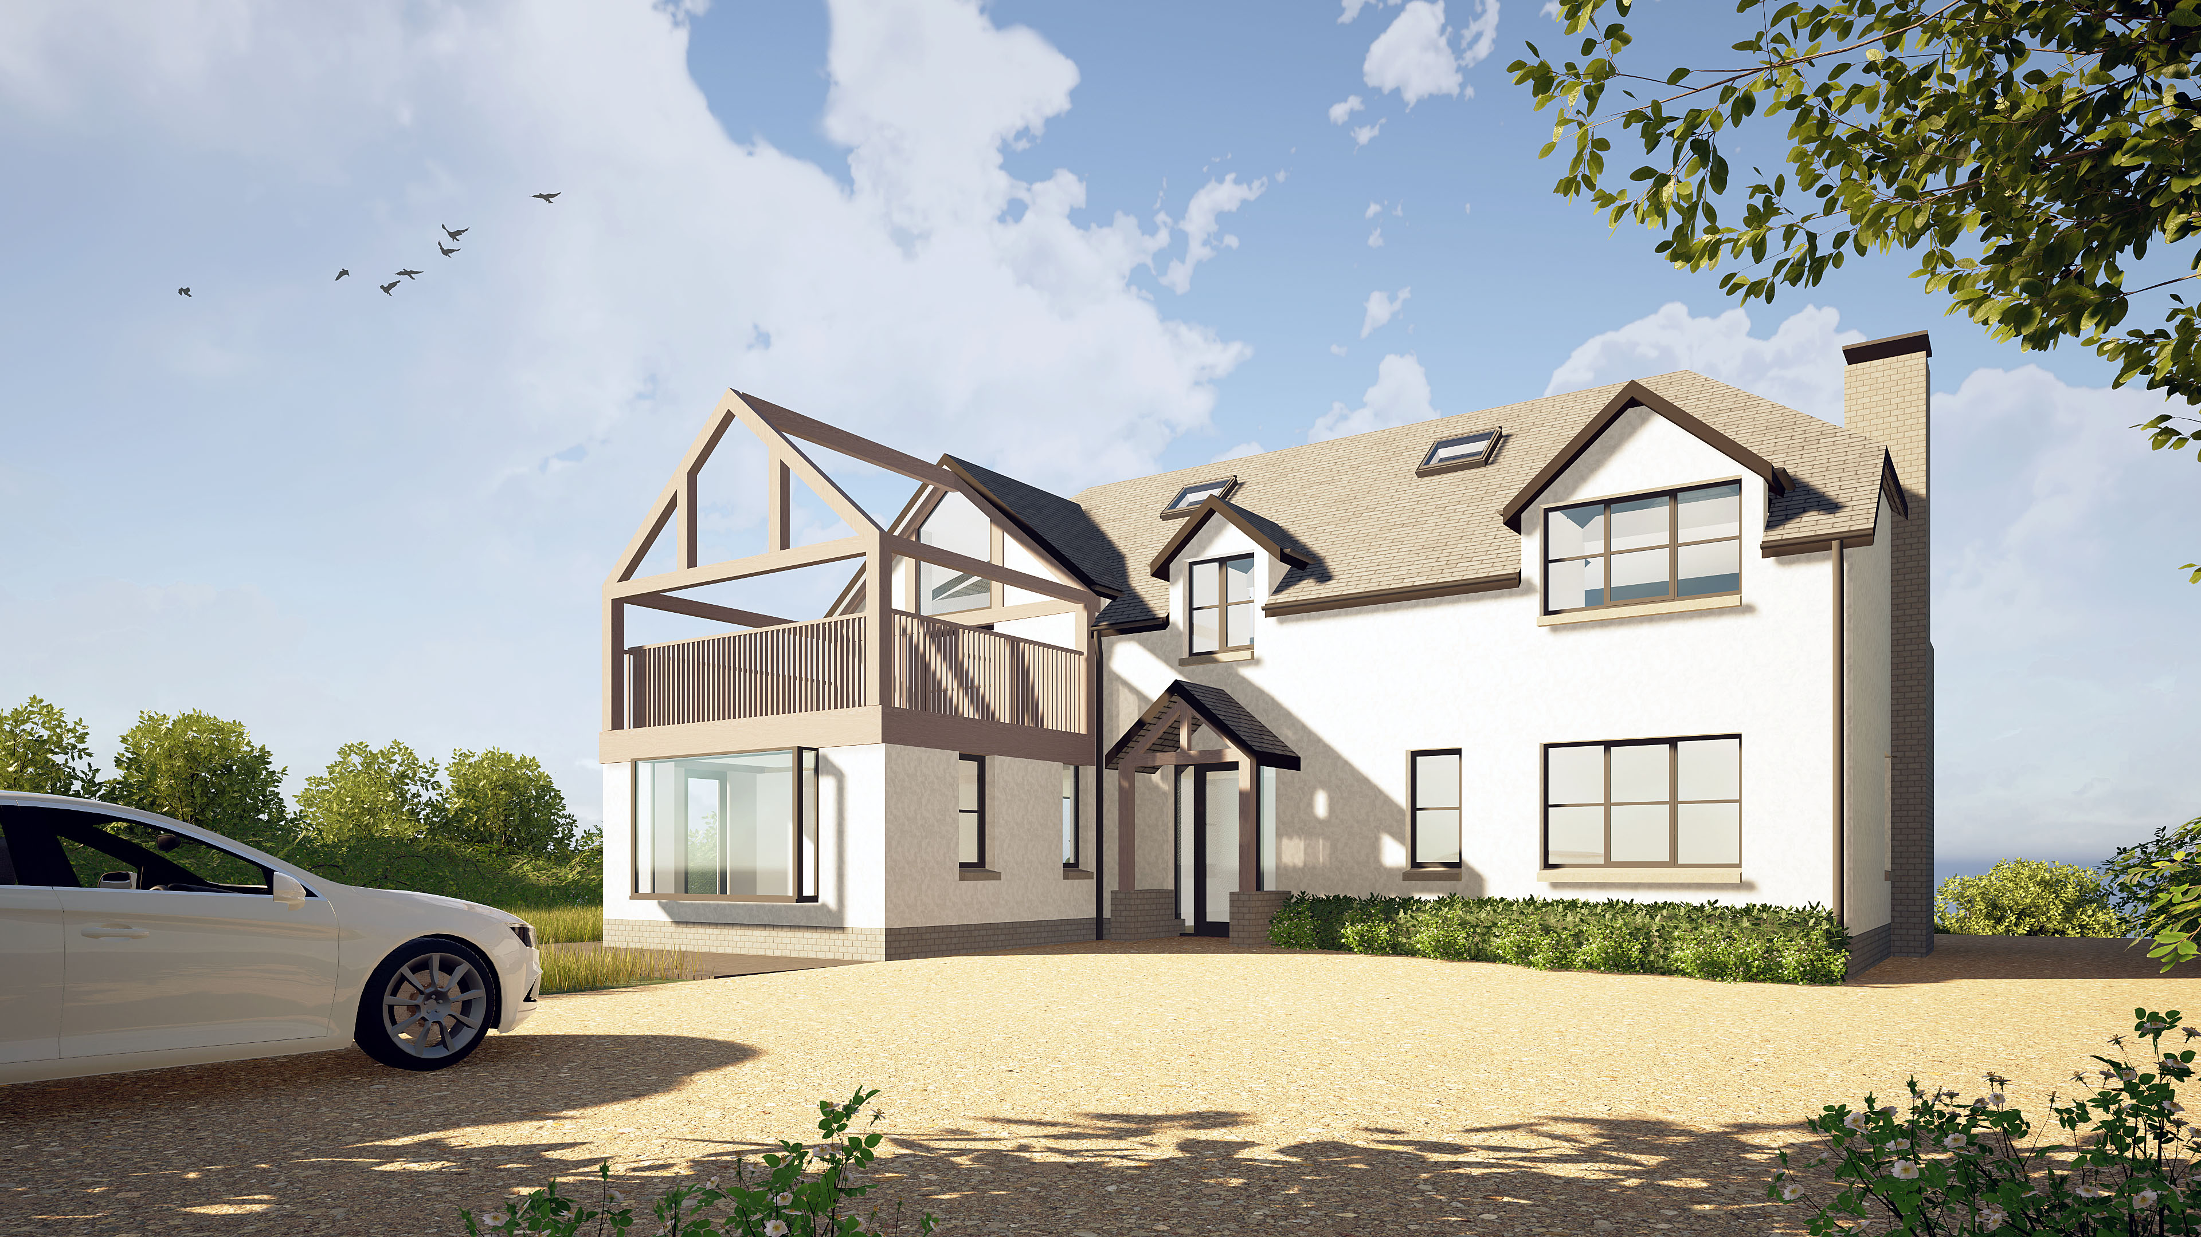

Slide 23
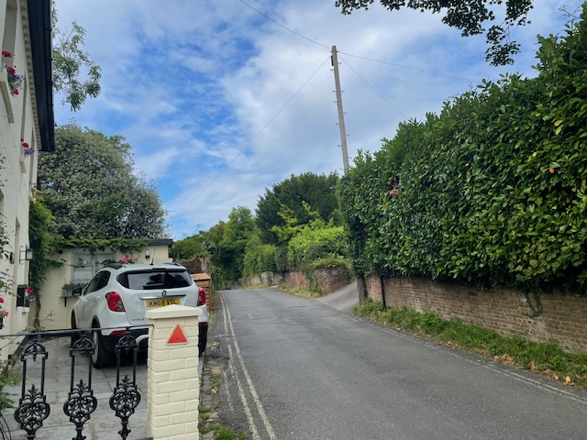
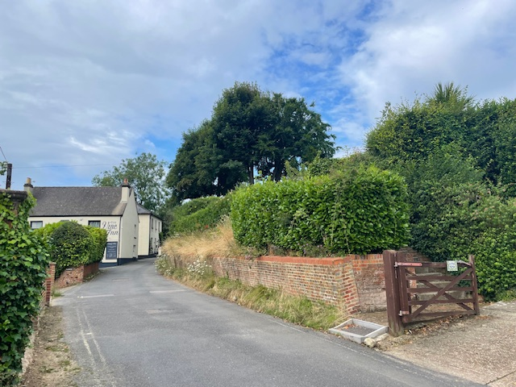
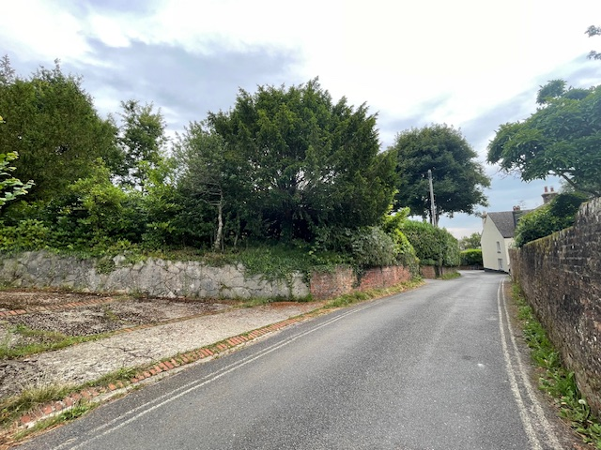
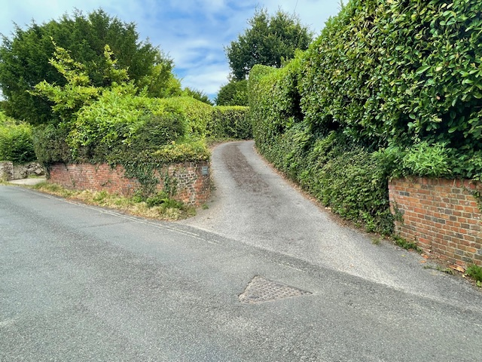
Further site photographs – views from High Street
Notes:
Top left – view from High Street looking towards site access; top right – view from further east along High Street showing vegetated boundaries; bottom left – view from further west along High Street, looking east towards site; bottom right – site access from High Street.

Slide 24
Assessment
The footprint of the dwelling is smaller than the existing cottage.
The proposed volume increase is proposed at 25.55%. However, this is considered acceptable. A condition is recommended to remove permitted development rights on the proposed property so further extensions cannot be built without the consent from the Local Planning Authority.
As originally submitted, the proposed property was to achieve 22.38% volume increase however, the design quality and overall scheme has been improved through amendments.
The steeper roof slope creates a more traditional form of dwelling with stronger gables and hipped ends which suits the character of the area.
Hampshire Highways have raised no objection.
Notes:
Heritage Consultant comment: The existing structure is of a relatively poor standard by today’s parameters and of no particular architectural interest, so combined with the families’ specific requirements is best replaced.

Slide 25
Recommendation
The proposal accords overall with local plan policy and provides a suitable replacement dwelling in terms of its character, residential amenity, ecological matters, and parking provision.
The proposal does not harm the Old Bursledon Conservation Area or the Special Policy Area.
The recommendation is to Permit, subject to conditions.

