Slide 1
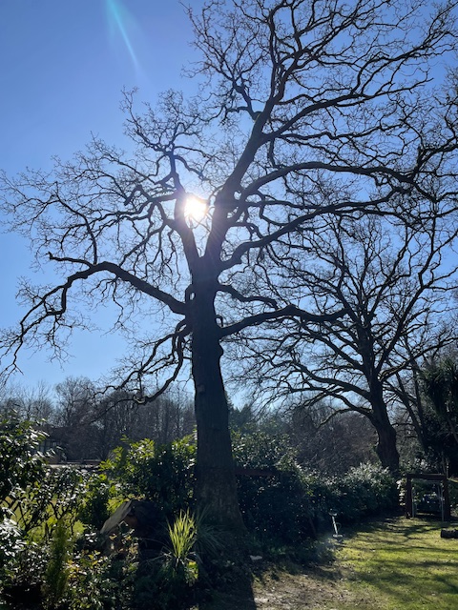
I have been advised by the HCC tree expert and a Tree Surgeon that about 30% of the tree needs to be pruned the bulk of which overlaps Merdon Junior school. This is for safety.
This means reducing the branches overlooking the field by 5 metres.

